Slide 1
NVMe, SCM etc
Chun Liu
Chun.Liu@Futurewei.com

Slide 2
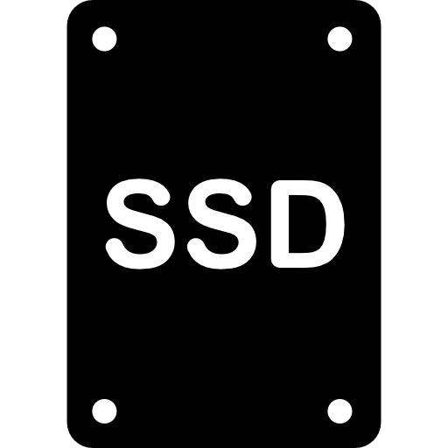
SAS NVMe SCM
Optane DIMM
DRAM
SCM
NVMe vs SAS
No more HBA, connect directly to PCIe
More bandwidth, lower latency
SCM DIMM vs NVMe
No more PCIe, connect directly to DRAM bus
More bandwidth, lower latency
Latency
Interface (DRAM < NVMe < SAS)
Media (SCM < FLASH)
DDR4 6 Channels
150GB/s, ~1200Gbps
SAS3 12Gbps
CPU
PCIe Gen4 40 Lanes
640Gbps
x40
PCIe X16
32Gbps
SAS HBA
PCIe Root
NVMe X4 8Gbps
SCM
Optane Drive

Slide 3
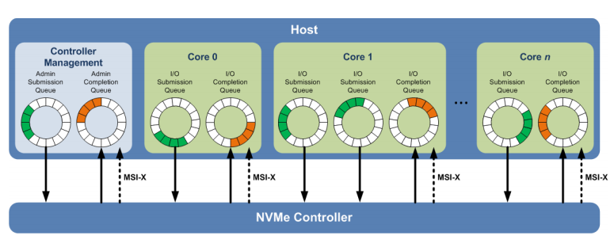
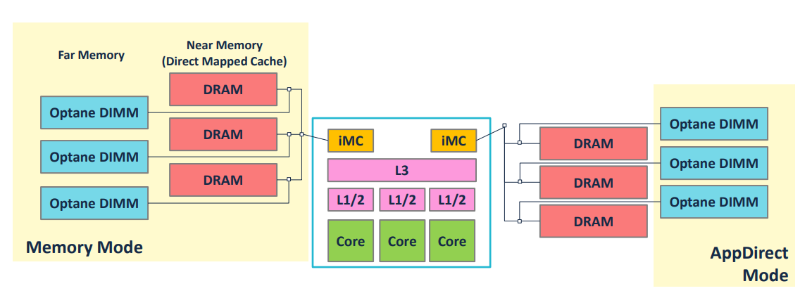
Deeper Dive
Credit: SNIA NVMe Express: Optimizing for PCIe SSD Performance
FAST 2019: An Empirical Guide to the Behavior and Use of Scalable Persistent Memory
Notes:
https://www.usenix.org/conference/fast20/presentation/yang

Slide 4
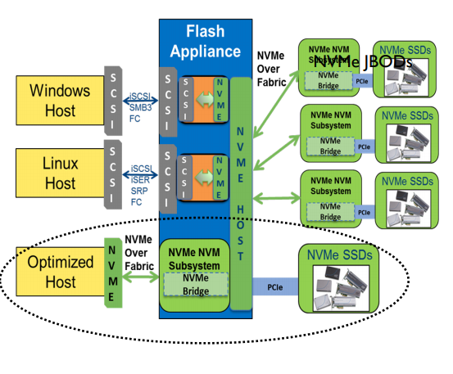
NVMe-over-Fabric
Choice of Fabric: FC / Ethernet
Ethernet: Huawei’s solution
FC: Huawei’s solution
Credit: SNIA SDC 2016 Under the Hood with NVMe over Fabrics

Slide 5
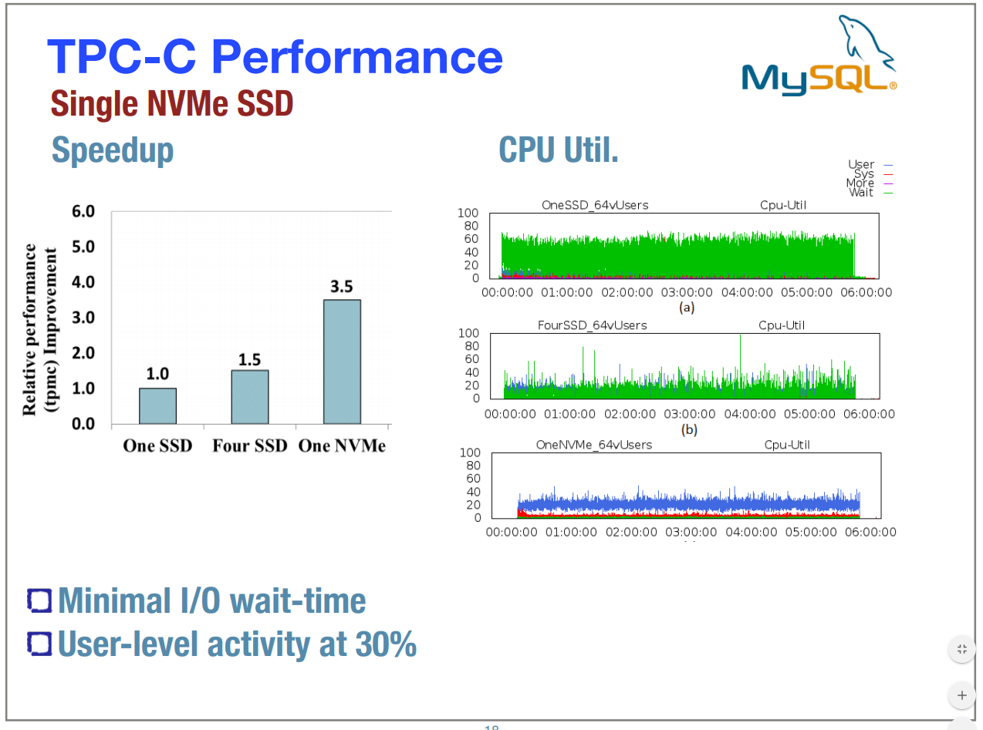
Use Cases
Cassandra
VMWare on NVMe
MySQL on NVMe
Performance 3.5x improvement on NVMe SSD over SATA SSD
Credit: Percona live 17 Performance Analysis of NVMe SSDs and their Implication on Real World Databases
Notes:
https://www.percona.com/live/17/sessions/performance-analysis-nvme-ssds-and-their-implication-real-world-databases

Slide 6
SCM in Huawei’s Offering
Huawei 2280 server with Intel Xeno v6 and Intel optane DIMM
Huawei RoCE NIC
Huawei RoCE Switch

Slide 7
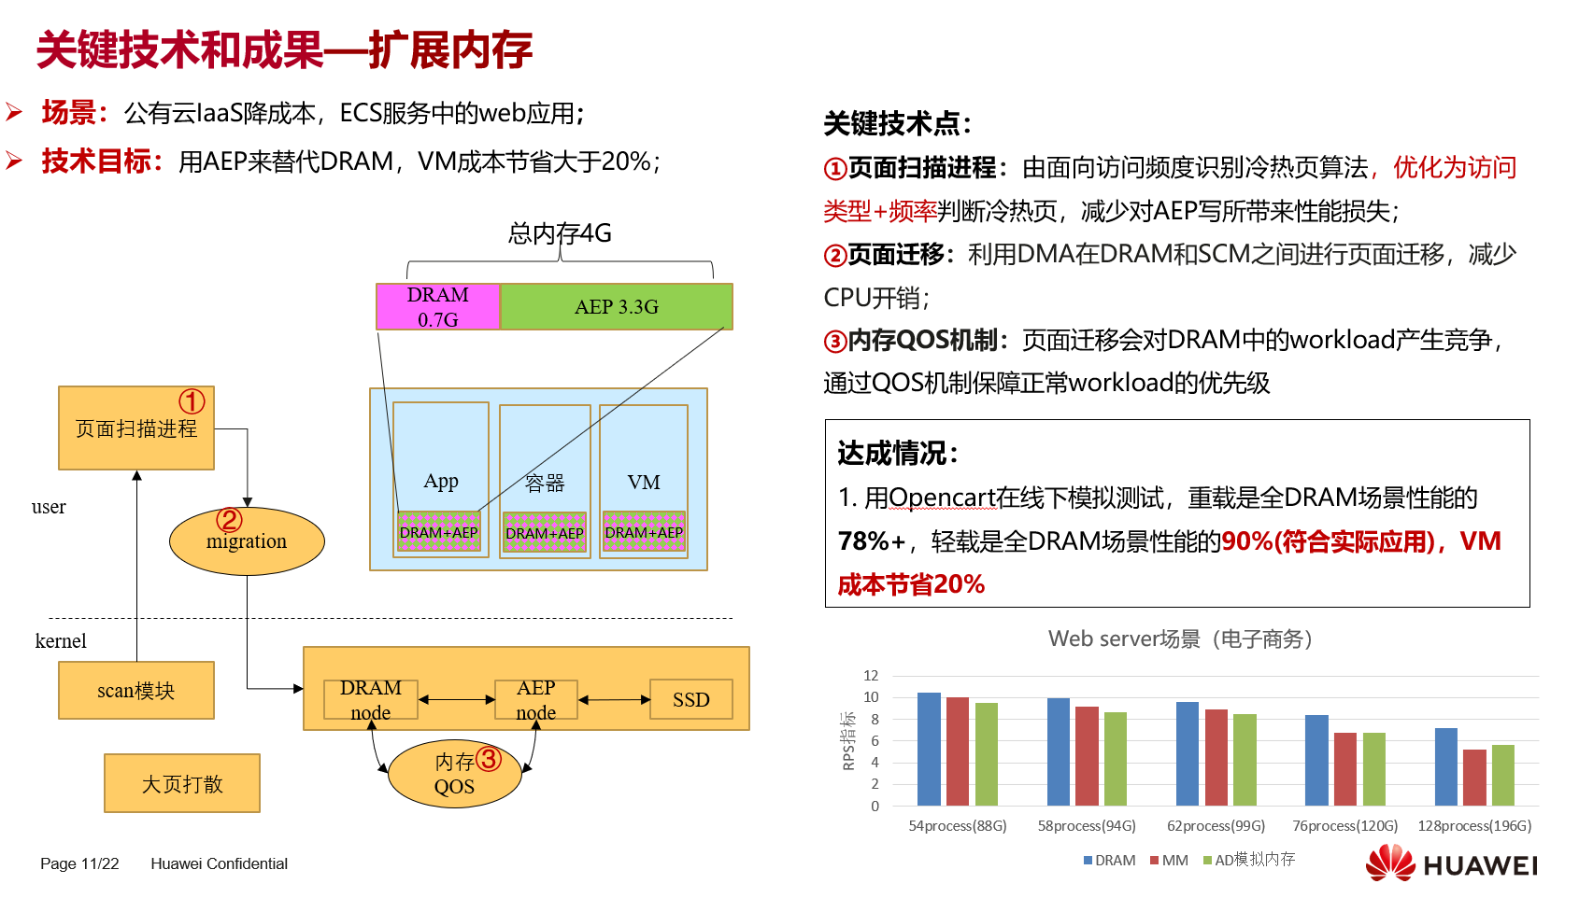
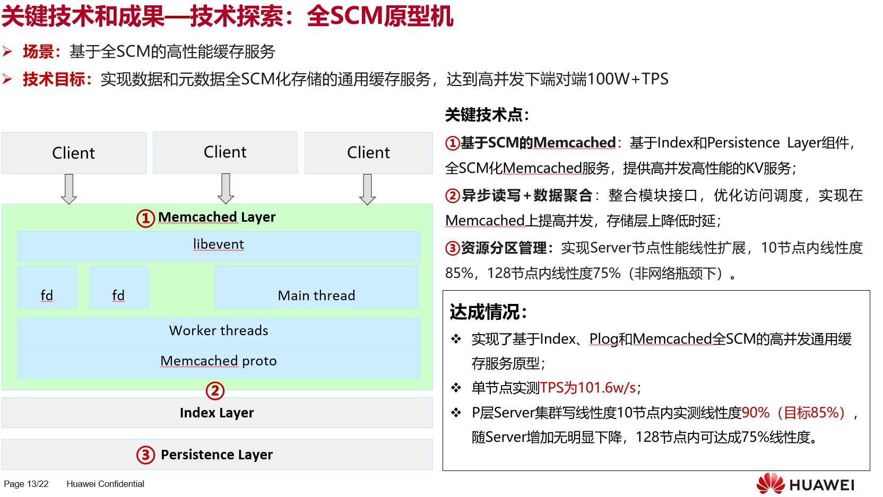
SCM Use Cases (Huawei Prototypes)
Use SCM as Big Memory:
Optane Memory Mode
IaaS cost scaling
Use the SCM as Big NV Memory
Optane App Direct Mode
Huawei ALL SCM Prototype Machine

